Slide 1
Udacity Connect Session
Session 1

Slide 2
Content
Introductions
Why Python
Why AI
Careers In AI
Some Important Notes
Next Week

Slide 3
Introductions
Professional
Personal
Country of origin and residence?
Career and background?
Why are you taking this course?
Favorite activities?
Recent life achievements?
Describe yourself in 2 – 3 words?

Slide 4
Why Python

Slide 5
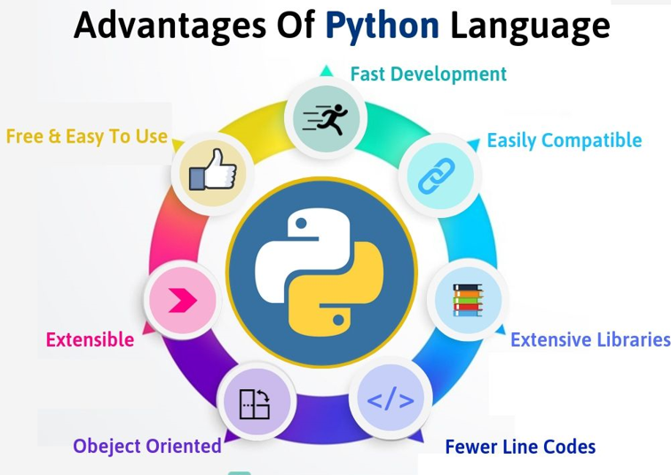
Why Python

Slide 6
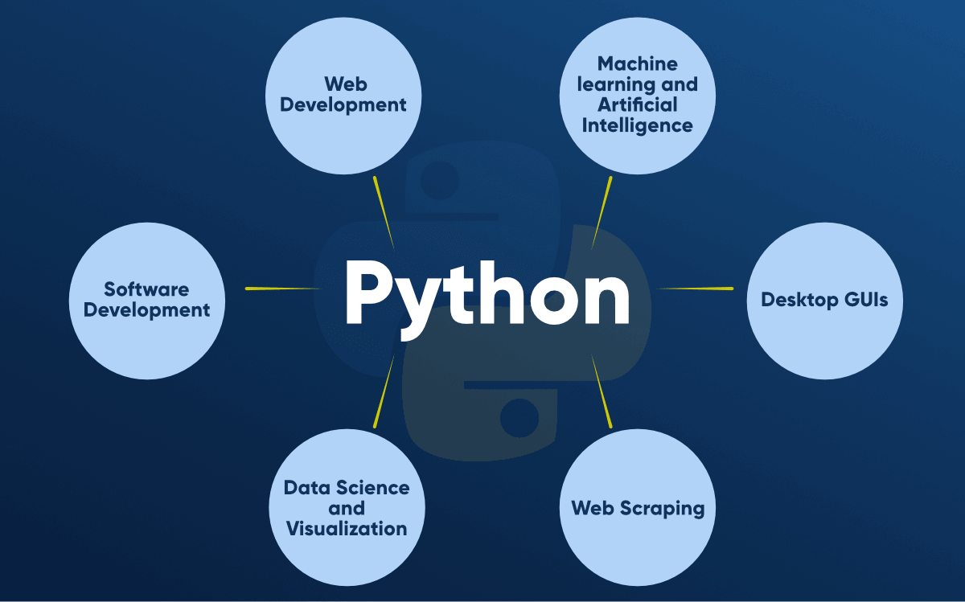
Why Python

Slide 7
Why AI

Slide 8
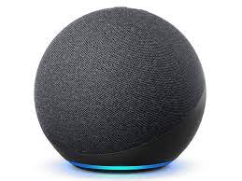
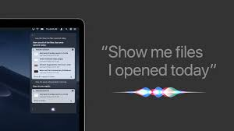
Speech to text
Why AI

Slide 9
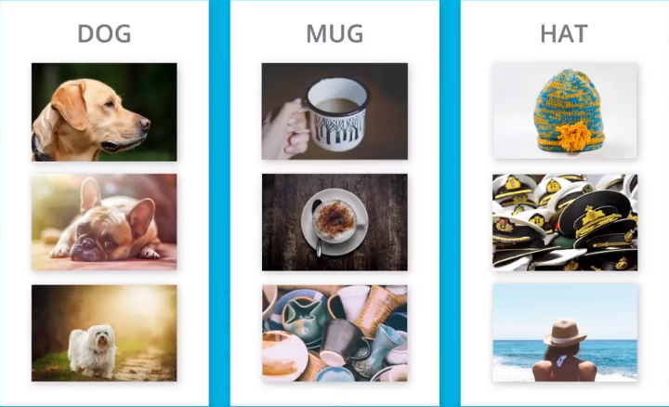
Image classification
Why AI

Slide 10
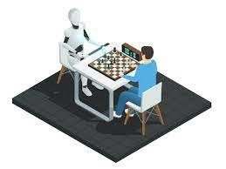
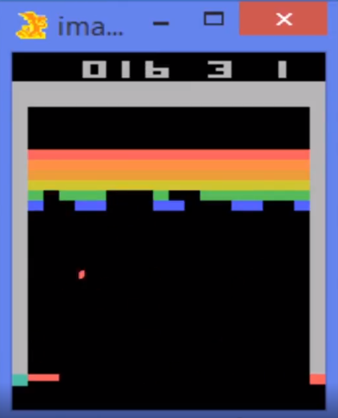
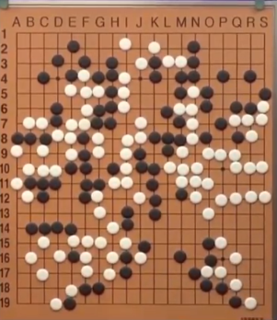
Games
Why AI

Slide 11
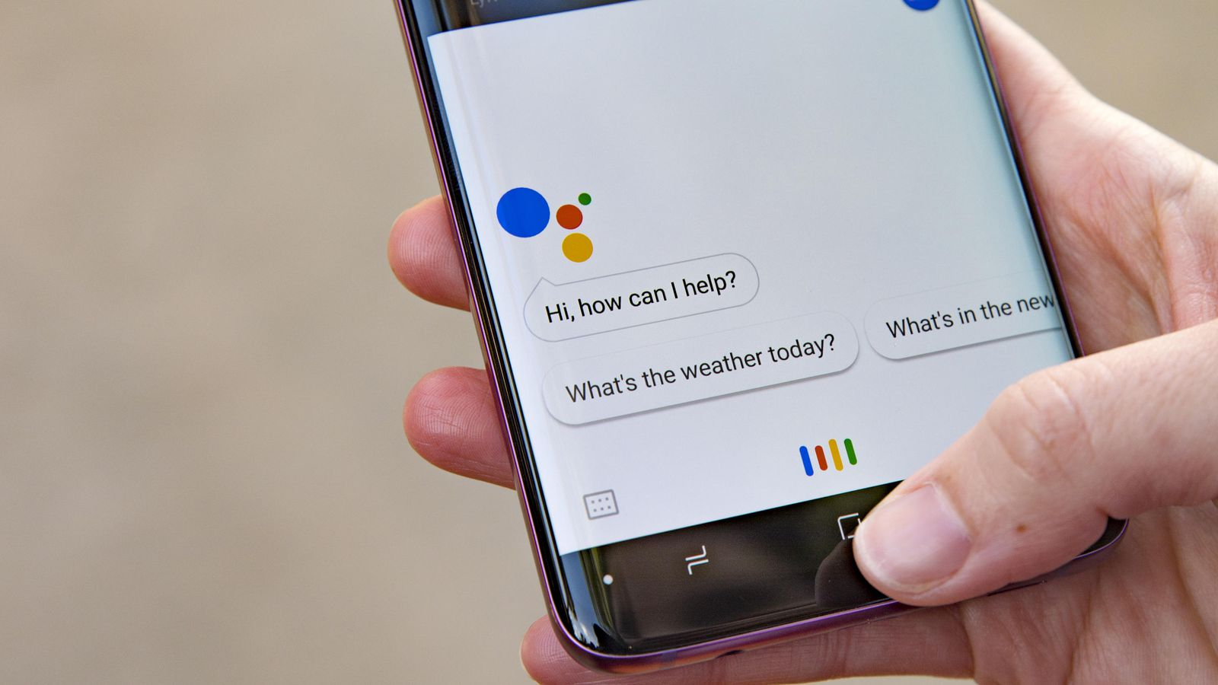
Chatbots
Why AI

Slide 12
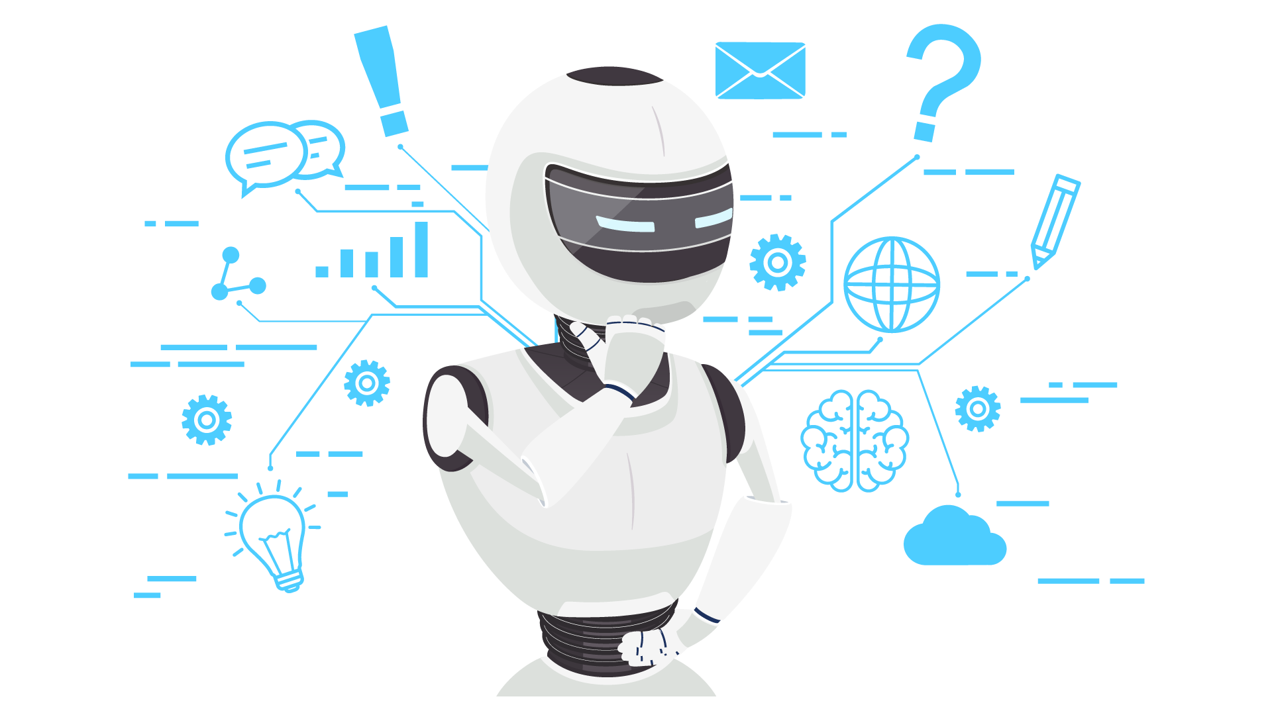
Marketing
Why AI

Slide 13

Healthcare
Why AI

Slide 14
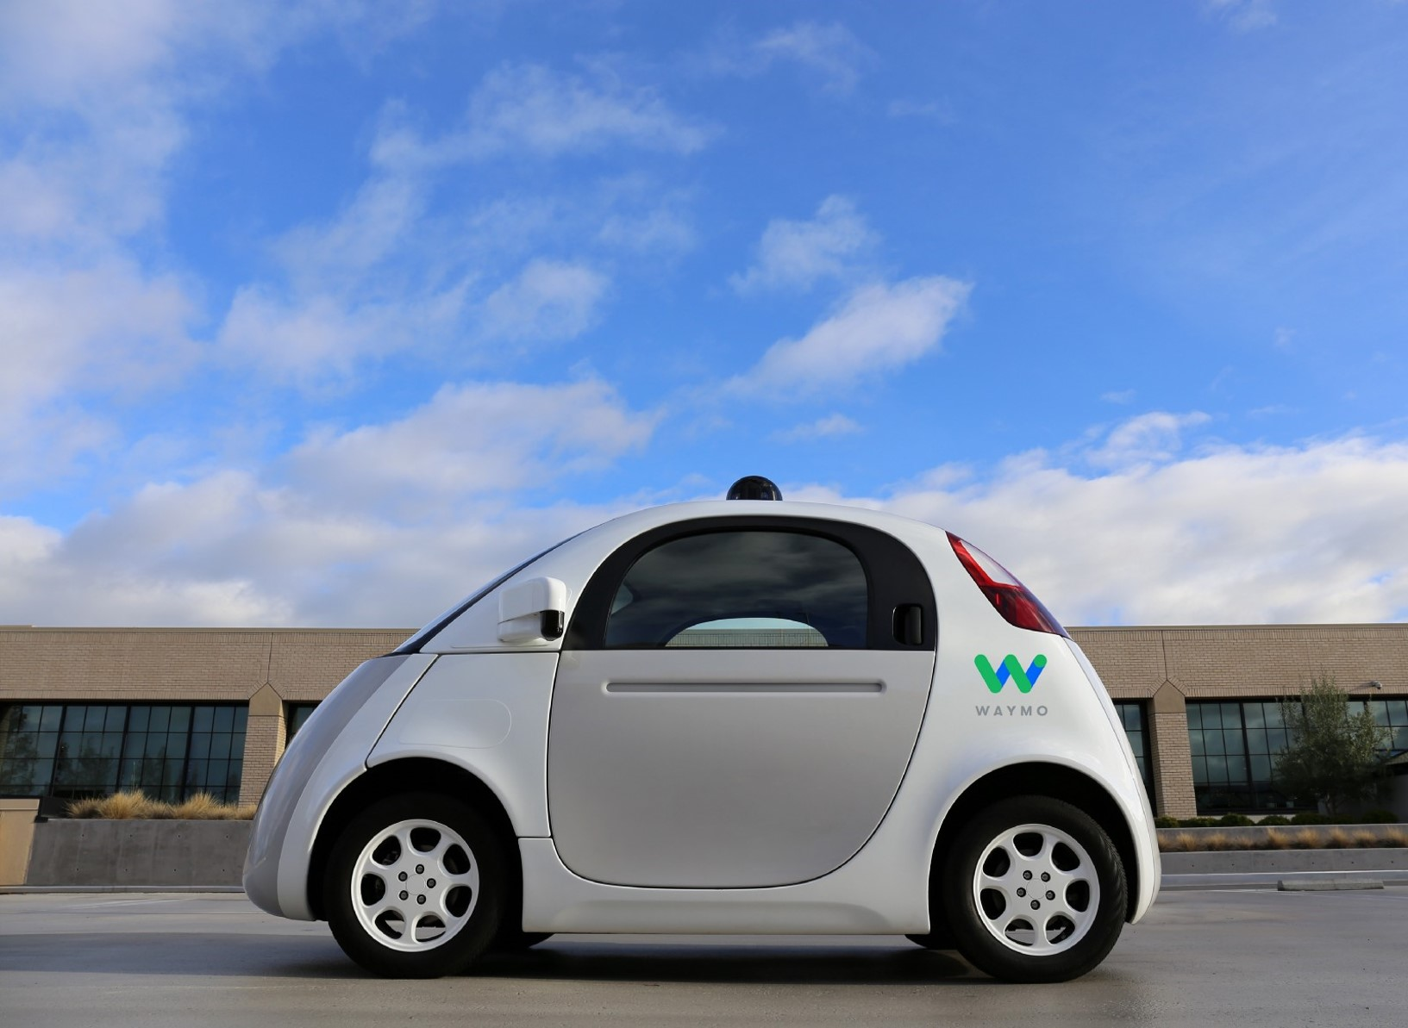
Autonomous vehicles
Why AI

Slide 15

Text To Art
Why AI
Flower in space with a person playing guitar in the background
Notes:
https://deepai.org/machine-learning-model/text2img

Slide 16
Careers in AI

Slide 17
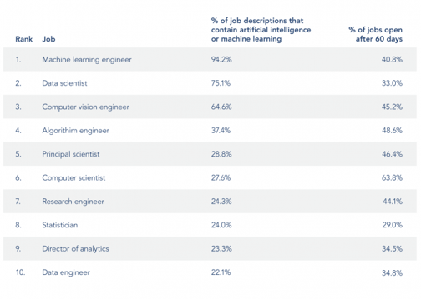
Careers in AI
Common job titles in the field of AI
Check this link for a detailed explanation of each job title

Slide 18
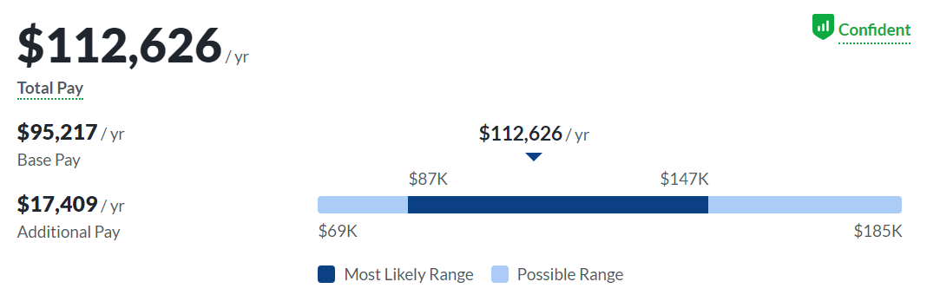
Salary of an AI engineer with < 1 year of experience
Careers in AI

Slide 19
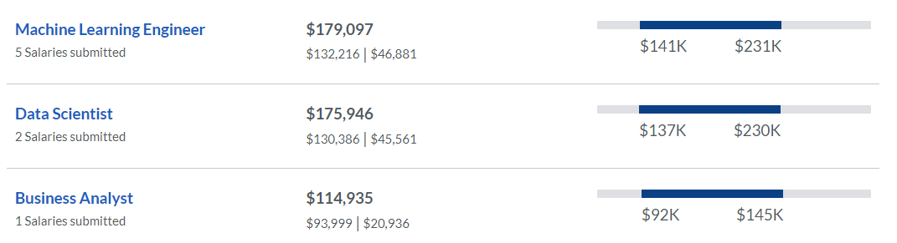
Salary of other related jobs with < 1 year of experience
Careers in AI

Slide 20
Break Time

Slide 21
Important Notes

Slide 22
Slack
Some Important Notes
Slack will be our main form of communication outside of the connect session
Slack group access
However you can also reach me via email: Abdullah.nasser2597@gmail.com
And you will find the sessions here

Slide 23
Connect session switch request
Some Important Notes
For those who wish to change their Connect session time fill this forum.

Slide 24
Connect session
Some Important Notes
Whenever possible, make sure you have a stable Internet connection for virtual sessions.
Please attend the session in a quiet place without any distractions.
Voice participation is mandatory, so be sure to have a working microphone!
Camera participation is not mandatory, but is welcomed.
Chat is monitored during the session, so please use appropriate language at all times.

Slide 25
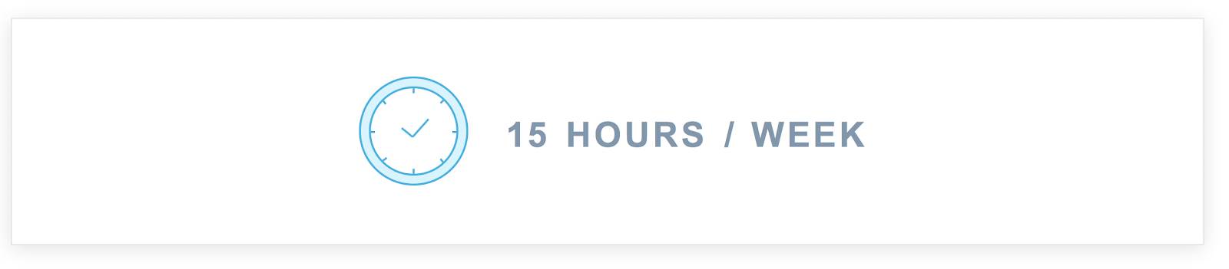
Classroom
Some Important Notes
Spending 10 – 15 hours on your nanodegree each week is recommended to graduate from the program

Slide 26
Revoking Warning
Some Important Notes
To avoid the risk of getting revoked from your Nanodegree and losing your scholarship, make sure you:
Submit your first projects on time and stay on track.
Attend your weekly Connect Session because attendance is mandatory.
Follow your weekly schedule and make the necessary progress in your classroom.
Follow the rules above to avoid losing your scholarship in the revoking cycle that will happen by the 5th week of this scholarship on July 14th, 2023.
Tip: Project reviewing might take from 1 to 3 days. We highly encourage you to try to submit your project as soon as you can and not wait until the last minute.

Slide 27
Project
Some Important Notes
Plagiarism (copying someone else’s work and presenting it as your own) is a violation of the Udacity Honor Code, and we must insist on no exceptions to this policy. Scholars who submit plagiarized work risk losing access to the scholarship program and their ability to graduate from the Nanodegree.

Slide 28
What to study before next session
Next Week
Introduction to python for AI programmers
Why python programming
Data types and operators
Data structures

Slide 29
Any Questions?

Slide 30
Thank You

